Slide 1
Cost of Capital
Concept of cost of capital
Applications of cost of capital in financial decision making,
Component cost of capital:
cost of debt,
cost of preferred stock,
the cost of retained earnings,
the cost of new common stocks;
Weighted average cost of capital (WACC);
Factors affecting the WACC.

Slide 2
Concept of Cost of Capital
Sometimes known as hurdle rate
Periodic interest at stated rate to the bondholders
Predetermined rate of dividend to preferred stockholders
Stock dividends for common shareholders
Cost of all long term sources of financing
It serve as a linkage between investment and financing decision
Rate that a firm must earn on its investment to satisfy all investors rate of return
Used as discount rate in investment evaluation process while using such techniques as net present value and internal rate of return
Cost of capital is the minimum rate of return a firm is required to earn on its investment in order to satisfy investors and to maintain its market value.

Slide 3
Application of Cost of Capital
Investment Decision
To compute NPV
IRR compared with NPV (IRR>NPR; accept project)
Capital Structure Decision
Minimize the cost and maximize the value
Combination of sources must minimize cost
Dividend Policy Decision
Payout earning or retain
Reinvestment rate > cost of retained; do not distribute dividend and vice versa
Performance Appraisal
Management

Slide 4
Components of Cost of Capital
Many sources of Financing but we will discuss about 4 of them:
Cost of Debt
Cost of Preferred stock
Cost of Retained Earning
Cost of new Common Stock

Slide 5
Cost of Debt
Creditor ship source of financing
Borrow funds from financial institution or may issue bonds or debenture
Interest expenses is tax deductible ; which will reduce cost of capital
Two Types:
Cost of Perpetual Debt or Irredeemable Debt
Cost of Redeemable Debt
With Coupon Payment
Zero Coupon Payment

Slide 6
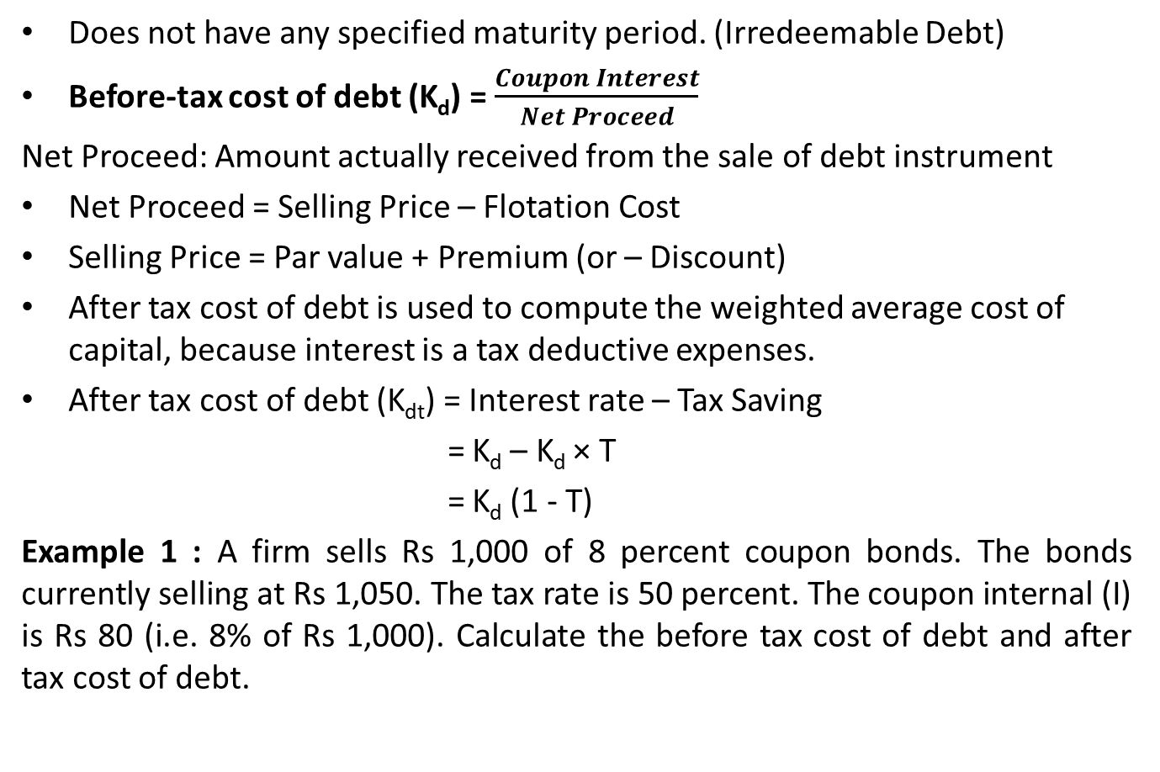
Cost of Perpetual Debt
Does not have any specified maturity period. (Irredeemable Debt)
Before-tax cost of debt (K_{d}) = $\frac{Coupon Interest}{Net Proceed}$
Net Proceed: Amount actually received from the sale of debt instrument
Net Proceed = Selling Price – Flotation Cost
Selling Price = Par value + Premium (or – Discount)
After tax cost of debt is used to compute the weighted average cost of capital, because interest is a tax deductive expenses.
After tax cost of debt (K_{dt}) = Interest rate – Tax Saving
= K_{d} – K_{d} × T
= K_{d} (1 - T)
Example 1 : A firm sells Rs 1,000 of 8 percent coupon bonds. The bonds currently selling at Rs 1,050. The tax rate is 50 percent. The coupon internal (I) is Rs 80 (i.e. 8% of Rs 1,000). Calculate the before tax cost of debt and after tax cost of debt.

Slide 7
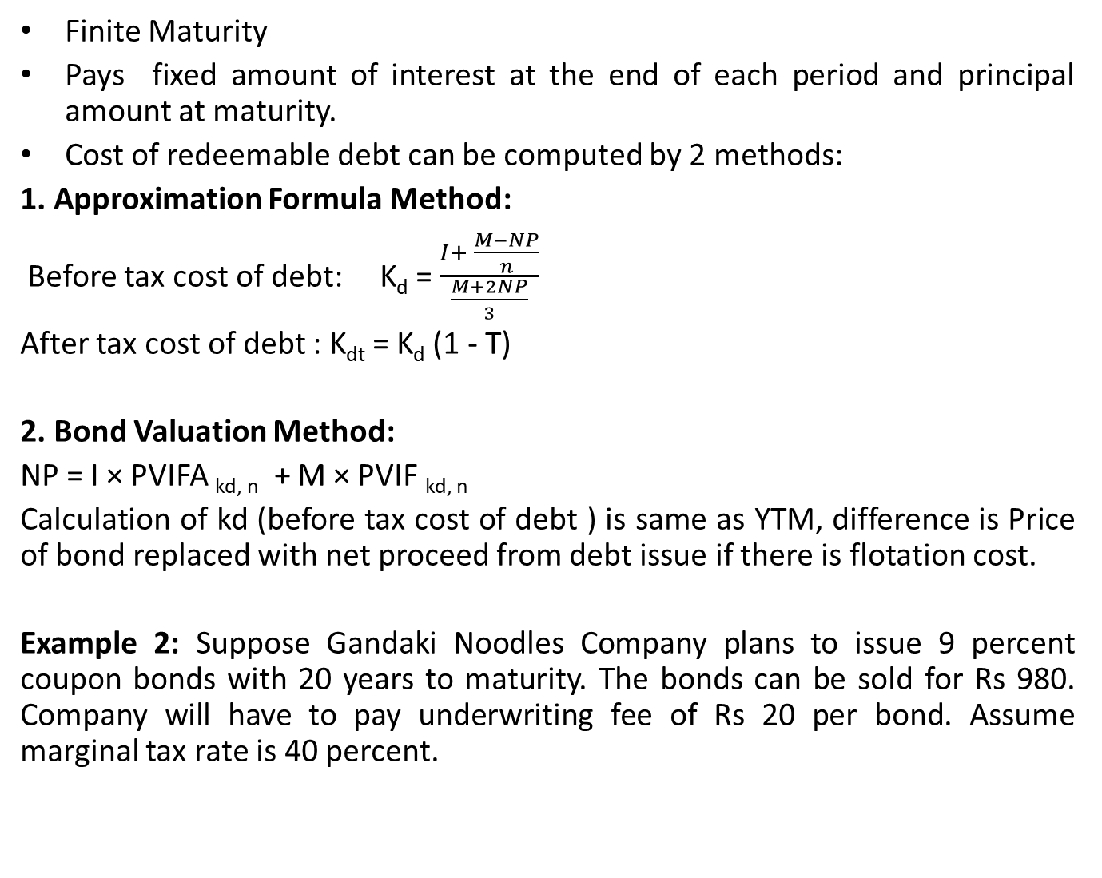
Cost of Redeemable Debt
Finite Maturity
Pays fixed amount of interest at the end of each period and principal amount at maturity.
Cost of redeemable debt can be computed by 2 methods:
1. Approximation Formula Method:
Before tax cost of debt: K_{d} = $\frac{I+ \frac{M−NP}{n}}{\frac{M+2NP}{3}}$
After tax cost of debt : K_{dt} = K_{d} (1 - T)
2. Bond Valuation Method:
NP = I × PVIFA _{kd, n} + M × PVIF _{kd, n}
Calculation of kd (before tax cost of debt ) is same as YTM, difference is Price of bond replaced with net proceed from debt issue if there is flotation cost.
Example 2: Suppose Gandaki Noodles Company plans to issue 9 percent coupon bonds with 20 years to maturity. The bonds can be sold for Rs 980. Company will have to pay underwriting fee of Rs 20 per bond. Assume marginal tax rate is 40 percent.

Slide 8
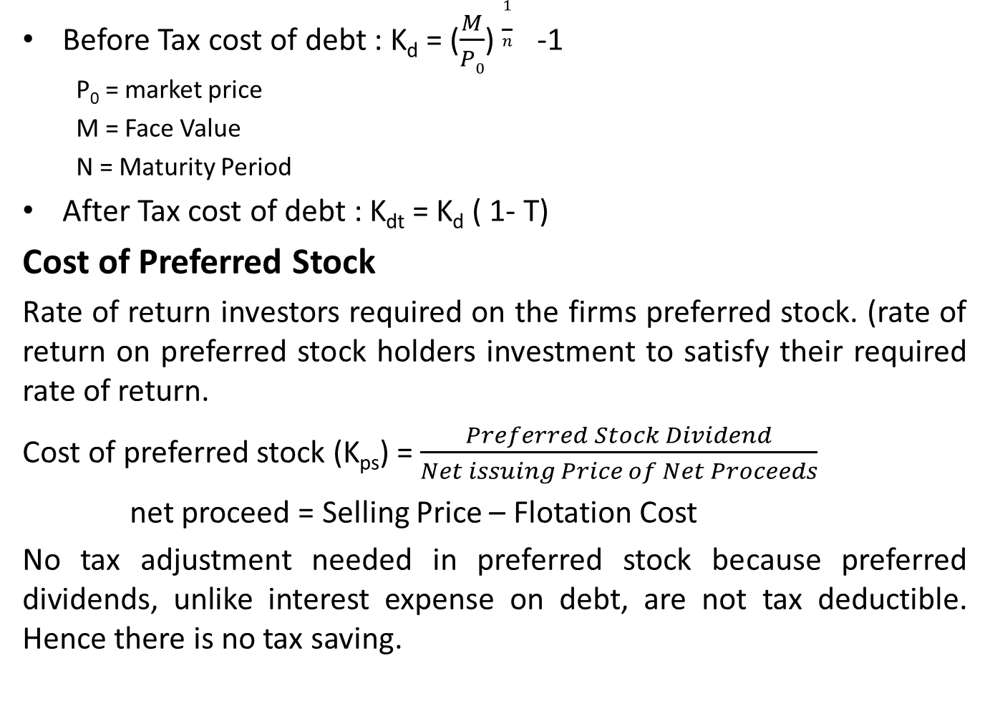
Cost of Redeemable Bond with Zero Coupon Payment
Before Tax cost of debt : K_{d} = ($\frac{M}{P0}$) $\frac{1}{n}$-1
P₀ = market price
M = Face Value
N = Maturity Period
After Tax cost of debt : K_{dt} = K_{d} ( 1- T)
Cost of Preferred Stock
Rate of return investors required on the firms preferred stock. (rate of return on preferred stock holders investment to satisfy their required rate of return.
Cost of preferred stock (K_{ps}) = $\frac{Preferred Stock Dividend}{Net issuing Price of Net Proceeds}$
net proceed = Selling Price – Flotation Cost
No tax adjustment needed in preferred stock because preferred dividends, unlike interest expense on debt, are not tax deductible. Hence there is no tax saving.

Slide 9
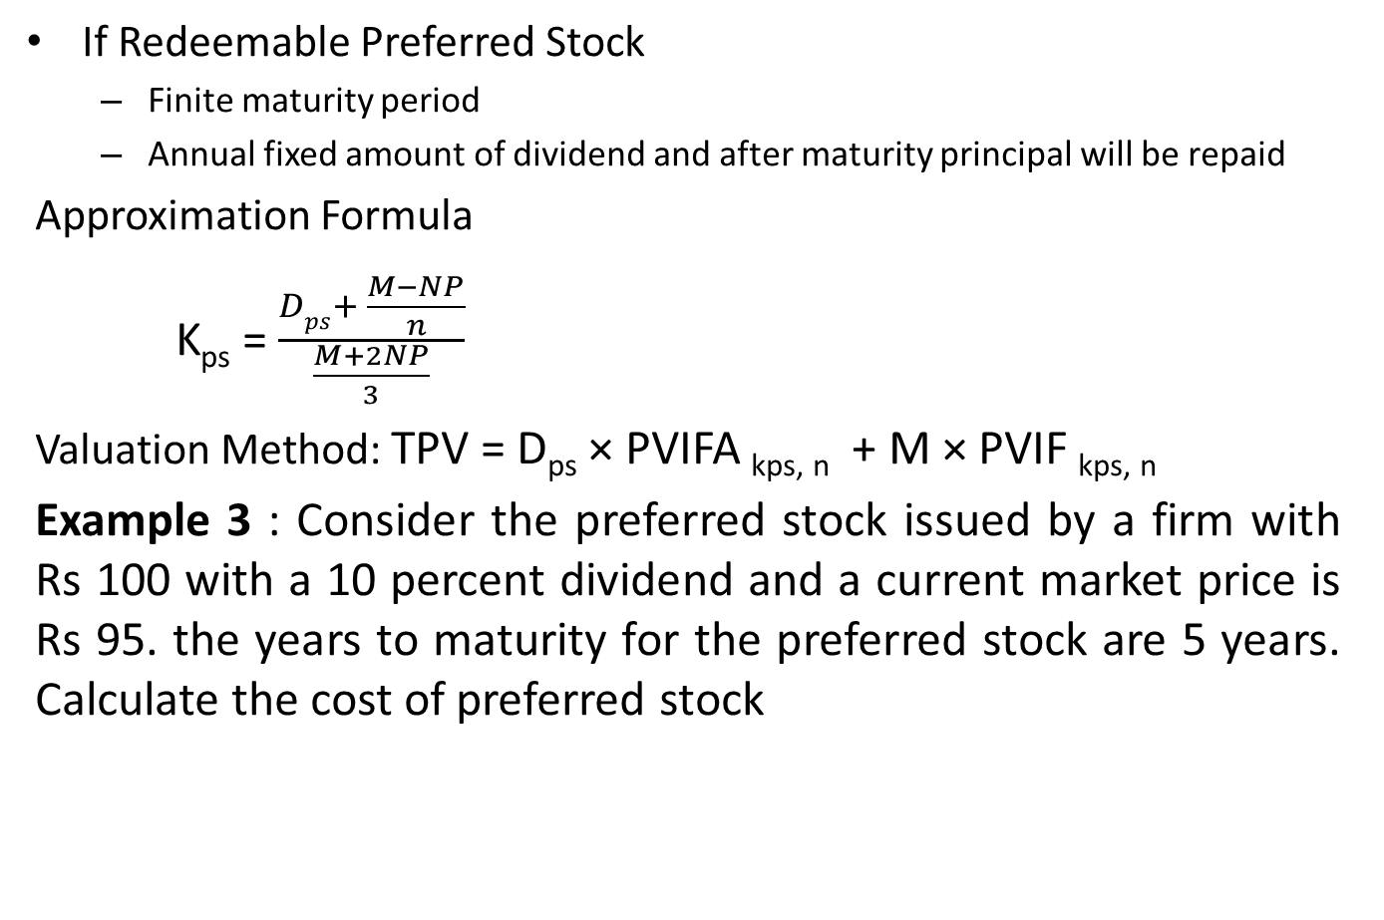
Cost of Preferred Stock
If Redeemable Preferred Stock
Finite maturity period
Annual fixed amount of dividend and after maturity principal will be repaid
Approximation Formula
K_{ps} = $\frac{Dps+ \frac{M−NP}{n}}{\frac{M+2NP}{3}}$
Valuation Method: TPV = D_{ps} × PVIFA _{kps, n} + M × PVIF _{kps, n}
Example 3 : Consider the preferred stock issued by a firm with Rs 100 with a 10 percent dividend and a current market price is Rs 95. the years to maturity for the preferred stock are 5 years. Calculate the cost of preferred stock

Slide 10
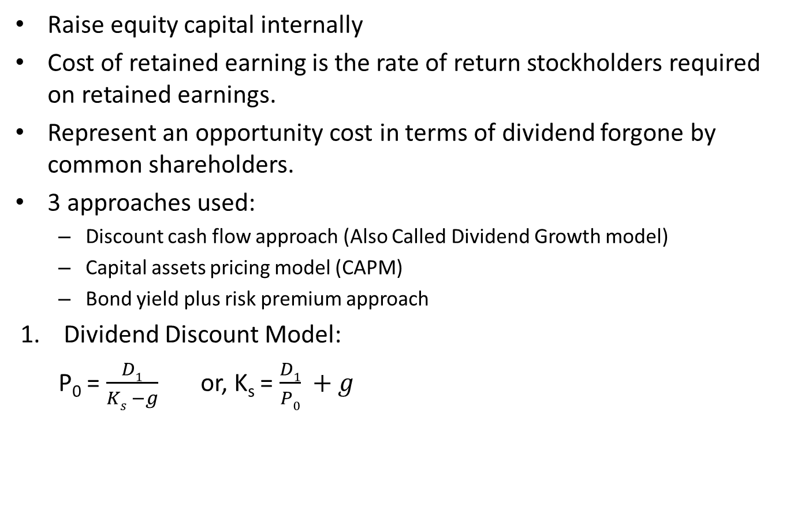
Cost of Retained Earning
Raise equity capital internally
Cost of retained earning is the rate of return stockholders required on retained earnings.
Represent an opportunity cost in terms of dividend forgone by common shareholders.
3 approaches used:
Discount cash flow approach (Also Called Dividend Growth model)
Capital assets pricing model (CAPM)
Bond yield plus risk premium approach
Dividend Discount Model:
P₀ = $\frac{D1}{Ks −g}$ or, K_{s} = $\frac{D1}{P0} +g$

Slide 11
Cost of Retained Earning
2. Capital Assets Pricing Model (CAPM)
Relationship between the non diversifiable risk of the firm and cost of common stock
K_{s} = R_{f} + [E (R_{m}) – R_{f} ]
3. Bond Yield Plus Risk Premium
K_{s} = Bond Yield + Risk Premium
(As we have discussed about same topics on previous chapters on details we shall directly proceed to some numerical problems rather than example problem)

Slide 12
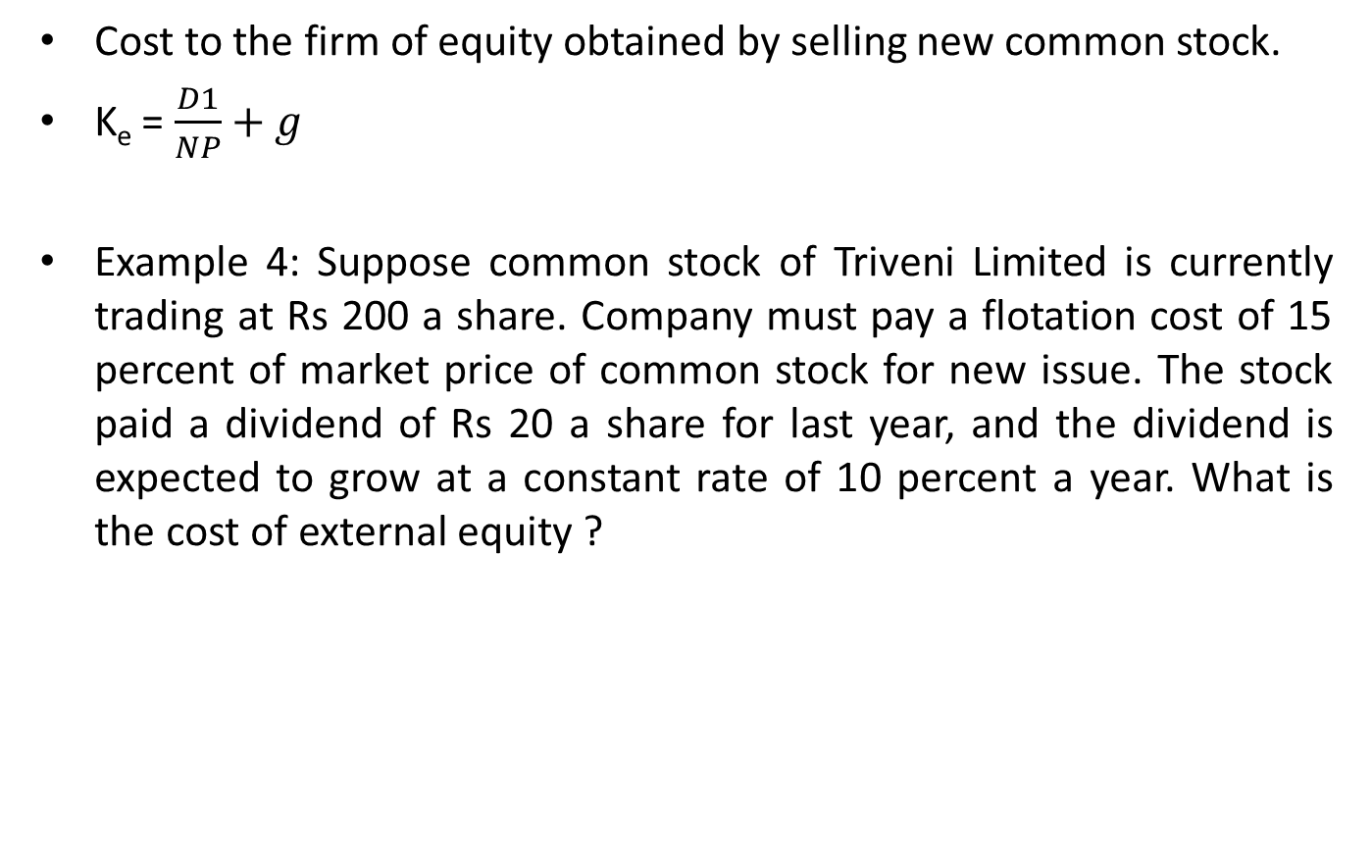
Cost of New Common Stock/ External Equity
Cost to the firm of equity obtained by selling new common stock.
K_{e} = $\frac{D1}{NP}+g$
Example 4: Suppose common stock of Triveni Limited is currently trading at Rs 200 a share. Company must pay a flotation cost of 15 percent of market price of common stock for new issue. The stock paid a dividend of Rs 20 a share for last year, and the dividend is expected to grow at a constant rate of 10 percent a year. What is the cost of external equity ?

Slide 13
Weighted Average Cost of Capital
Weighted average of after-tax costs of debt, preferred stock and common equity.
Steps Involved:
Calculate the after tax component cost
Find the weights of each source of financing
Multiply the after tax cost of each source by its weight (proportion) in capital structure
Add the weighted component costs to get the firms WACC
WACC is computed by using two weights basis:
WACC on the basis of Book Value
WACC on the basis of Market Value
WACC = K_{dt} × W_{d} + K_{ps} × W_{ps} + K_{s} × W_{s} + K_{e} × W_{e}
Example 5: Assume the Star Food Compant (SFC) has the capital structure consist of 47.5% debt, 2.5% preferred stock and 50% common equity. The cost of debt is 10%, cost of preferred stock is 10% and cost of retained earning is 18%. Tax rate is 40%. Calculate the WACC of the firm.

Slide 14
Marginal Cost of Capital
Cost of raising an additional rupee of capital
Weighted average cost of new or incremental capital
Weighted marginal cost of capital reflects the fact that as the volume of the total new financing increases the cost of various types of financing will increase, raising firm’s cost of capital.
Marginal cost of capital is increasing function of level of total new financing.
Marginal cost of capital Schedule
Graph that shows how the WACC changes as more and more new capital is raised by the firm
Break point is the rupee volume of new capital that can be raised before an increase in the firms marginal cost of capital.
Change in any one source of long term financing results break point.
Discussion on Retained Earning Break Point of page number 286 of Asmita Publication

Slide 15
Factors Affecting Cost of Capital
Uncontrollable Factors
Interest Rate
Taxes
Market Risk Premium
Controllable Factors
Capital Structure
Dividend Policy
Investment Policy

